Slide 1
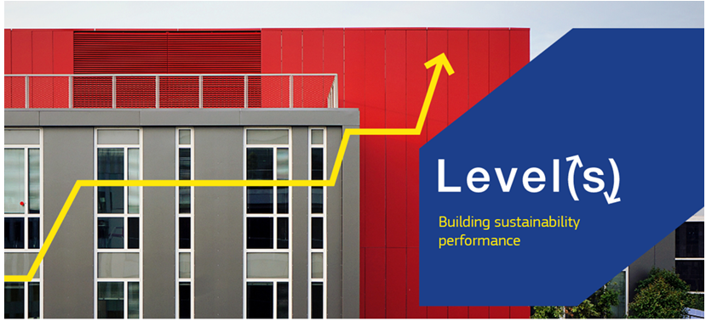
Taking life cycle from niche to new normal
Josefina Lindblom

Slide 2
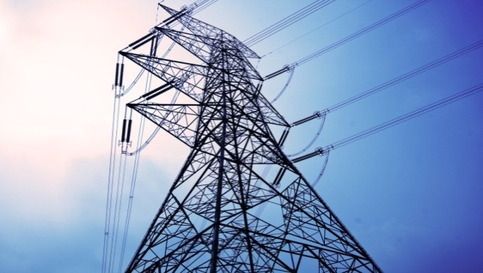

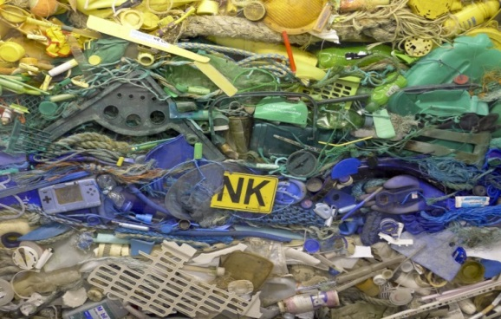


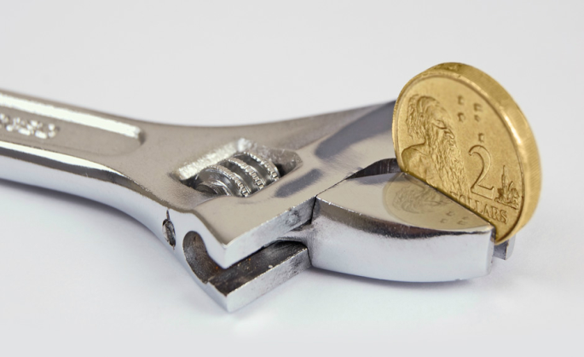
Images courtesy of Judit Kimpian, ACE
Notes:
Level(s) has two handfuls of indicators, in six different areas:
The first three are linked to use of resources over the full life cycle: energy, water and materials (including construction and demolition waste)
The remaining three are linked to the quality and the value of the building: health and comfort, resilience to climate change and life cycle costing
The last three were added after a strong message from stakeholders that they were necessary to give a complete picture of the building, and to make the tool interesting for the mainstream market.

Slide 3


Slide 4

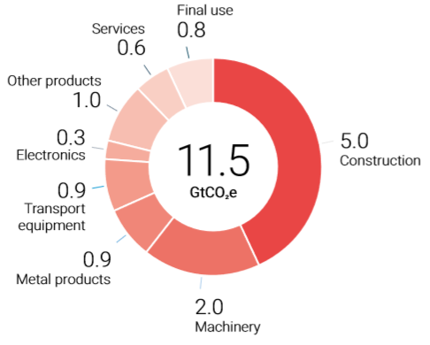
Notes:
GHG emissions in GtCO2e associated with materials production by the first use of materials in subsequent production processes or final consumption.
The production of materials is a significant source of GHG emissions and this is increasing; in 1995: 5 GtCO2e (15% of total global emissions), and in 2015; 11 GtCO2e (23%).
Materials produced for construction are the most important, with 5 GtCO2e.
This is more than the direct CO2 emissions from fuel combustion in buildings, which are 3 GtCO2e.
Material efficiency strategies, although effective, have been systematically overlooked in climate policies.
The report discusses how building codes could include embodied carbon for new construction.

Slide 5



Slide 6
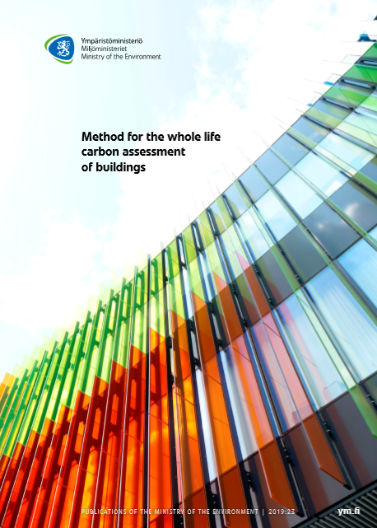

Slide 7


Slide 8

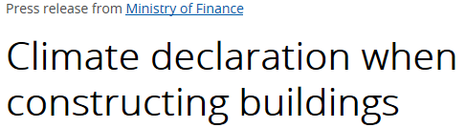

Slide 9
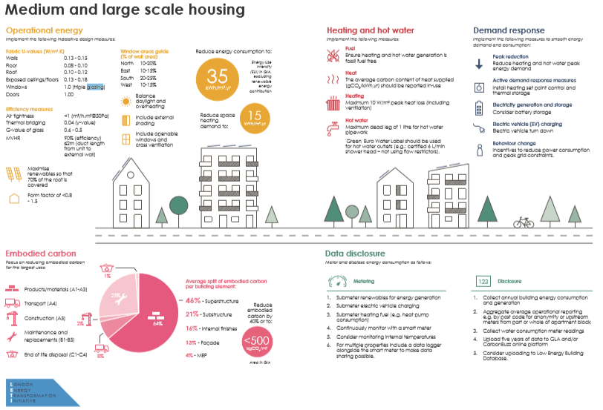

Slide 10

Link circular economy and a carbon neutral Europe
Integrate life cycle thinking into building codes and procurement
Comparable life cycle data, enabling learning and benchmarking
Support normal building projects to consider life cycle
Certification schemes assuring their work reflects European policy
European sustainability “yardstick” for investors, valuers and companies

Slide 11
For the investor
Indoor environment quality, now and future
Adaptability/flexibility/service life
Energy and water consumption
Life cycle cost/future maintenance cost
Embodied carbon (….. future legislation)

Slide 12
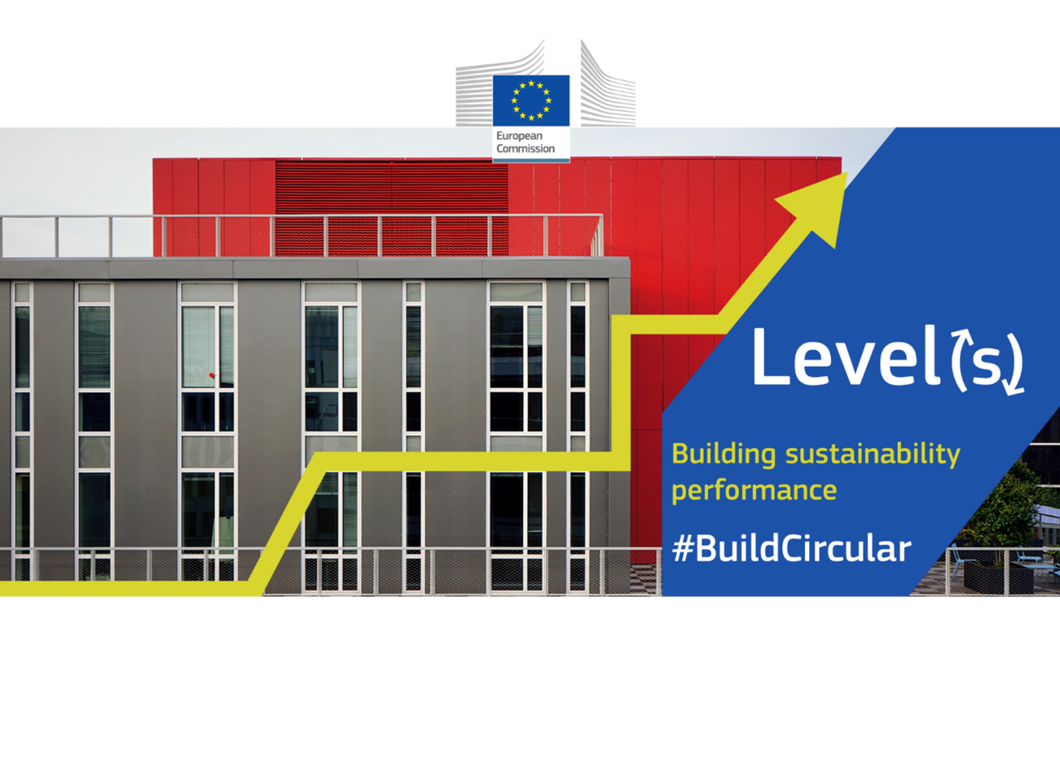

Slide 13
